Slide 1
Mass and Moles of a Substance
Chemistry requires a method for determining the numbers of molecules in a given mass of a substance.
This allows the chemist to carry out “recipes” for compounds based on the relative numbers of atoms involved.
The calculation involving the quantities of reactants and products in a chemical equation is called stoichiometry.
Notes:
2

Slide 2
Molecular Weight and Formula Weight
The molecular weight of a substance is the sum of the atomic weights of all the atoms in a molecule of the substance.
For, example, a molecule of H₂O contains 2 hydrogen atoms (at 1.0 amu each) and 1 oxygen atom (16.0 amu), giving a molecular weight of 18.0 amu.
Notes:
2

Slide 3
Molecular Weight and Formula Weight
The formula weight of a substance is the sum of the atomic weights of all the atoms in one formula unit of the compound, whether molecular or not.
For example, one formula unit of NaCl contains 1 sodium atom (23.0 amu) and one chlorine atom (35.5 amu), giving a formula weight of 58.5 amu.
Notes:
2

Slide 4
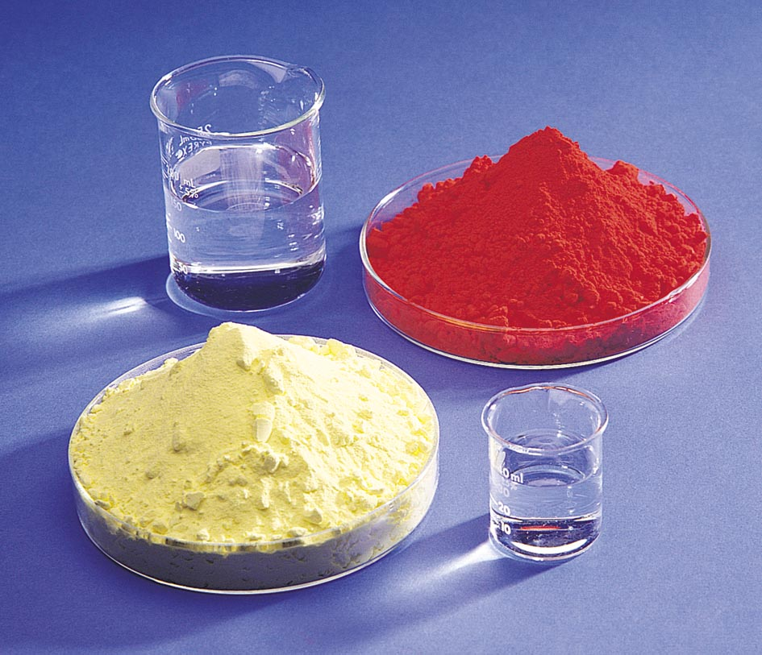
Mass and Moles of a Substance
The Mole Concept
A mole is defined as the quantity of a given substance that contains as many molecules or formula units as the number of atoms in exactly 12 grams of carbon–12.
The number of atoms in a 12-gram sample of carbon–12 is called Avogadro’s number (to which we give the symbol N_{a}). The value of Avogadro’s number is 6.02 x 10²³.
1-octanol
Mercury(II) Iodide
Sulfur
Methanol
Notes:
2

Slide 5
Mass and Moles of a Substance
The molar mass of a substance is the mass of one mole of a substance.
For all substances, molar mass, in grams per mole, is numerically equal to the formula weight in atomic mass units.
That is, one mole of any element weighs its atomic mass in grams.
Notes:
2

Slide 6
Mass and Moles of a Substance
Mole calculations
Suppose we have 100.0 grams of iron (Fe). The atomic weight of iron is 55.8 g/mol. How many moles of iron does this represent?
Notes:
2

Slide 7
Mass and Moles of a Substance
Mole calculations
Conversely, suppose we have 5.75 moles of magnesium (atomic wt. = 24.3 g/mol). What is its mass?
Or 1.40 x 10² grams of Mg
Notes:
2

Slide 8
Mass and Moles of a Substance
Mole calculations
This same method applies to compounds. Suppose we have 100.0 grams of H₂O (molecular weight = 18.0 g/mol). How many moles does this represent?
Notes:
2

Slide 9
Mass and Moles of a Substance
Mole calculations
Conversely, suppose we have 3.25 moles of glucose, C₆H₁₂O₆ (molecular wt. = 180.0 g/mol). What is its mass?
Notes:
2

Slide 10
Mass and Moles and Number of Molecules or Atoms
The number of molecules or atoms in a sample is related to the moles of the substance:
Suppose we have a 3.46-g sample of hydrogen chloride, HCl. How many molecules of HCl does this represent?
Notes:
2

Slide 11
How many atoms?
How many atoms are in 0.10 moles of Uranium atoms?
Convert to
Moles Atoms
6.02 x 10²³ atoms
0.10 moles U ----------------------- = 6.0 x 10²² U atoms
1 mole
What is the mass of 0.10 moles of Uranium atoms?
Convert to
Moles Grams
238.029 g U
0.10 moles U ----------------------- = 24 grams U
1 mole U

Slide 12
Practice with Propane (C₃H₈)
How many molecules are in 1.00 mole of Propane?
Convert to
Moles Molecules
6.02 x 10²³ molecules
1.00 mole C₃H₈ ----------------------------- = 6.02 x 10²³ C₃H₈ molecules
1 mole
What is the mass of 1.00 mole of propane molecules?
Convert to
Moles Grams
44.096 g C₃H₈
1.00 mole C₃H₈ ----------------------- = 44.1 grams C₃H₈
1 mole C₃H₈

Slide 13
Practice with Propane (C₃H₈)
How many H atoms are in 1.00 mole of Propane?
Convert to
Moles Propane atoms of H atoms
8 moles of H 6.02 x 10²³ atoms
1.00 mole C₃H₈ ------------------- ------------------------ = 4.82 x 10²⁴ H atoms
1 mole C₃H₈ 1 mole H
How many grams of carbon are there in 2.4g C₃H₈?
Convert to
Grams Grams
1 mole_{p} 3 mole_{c} 12.011g
2.4 g_{p} ----------- ----------- ----------- = 2.0 grams carbon
44.096 g 1 mole_{p} 1 mole_{c}

Slide 14
Determining Chemical Formulas
The percent composition of a compound is the mass percentage of each element in the compound.
We define the mass percentage of “A” as the parts of “A” per hundred parts of the total, by mass. That is,
Notes:
2

Slide 15
Mass Percentages from Formulas
Let’s calculate the percent composition of butane, C₄H₁₀.
First, we need the molecular mass of C₄H₁₀.
Now, we can calculate the percents.
Notes:
2

Slide 16
Percent Composition
What is the % composition of C₆H₁₂O₆?
12.011g C
72.066 180.155
6 moles C -------------- = 72.066 g C
x100%=40.0% C
1 mole C
1.0079g H
12.0948 180.155
12 moles H -------------- = 12.0948 g H
x100%=6.7% H
1 mole H
15.999g O
95.994 180.155
6 moles O -------------- = 95.994g O
x100%=53.3% O
1 mole O
180.155
% composition is 40.0% C, 6.7% H, and 53.3% O

Slide 17
Determining Chemical Formulas
Determining the formula of a compound from the percent composition.
The percent composition of a compound leads directly to its empirical formula.
An empirical formula (or simplest formula) for a compound is the formula of the substance written with the smallest integer (whole number) subscripts.
Notes:
2

Slide 18
Determining Chemical Formulas
Determining the empirical formula from the percent composition.
Benzoic acid is a white, crystalline powder used as a food preservative. The compound contains 68.8% C, 5.0% H, and 26.2% O by mass. What is its empirical formula?
In other words, give the smallest whole-number ratio of the subscripts in the formula
C_{x} H_{y}O_{z}
Notes:
2

Slide 19
Determining Chemical Formulas
Determining the empirical formula from the percent composition.
For the purposes of this calculation, we will assume we have 100.0 grams of benzoic acid.
Then the mass of each element equals the numerical value of the percentage.
Since x, y, and z in our formula represent mole-mole ratios, we must first convert these masses to moles.
C_{x} H_{y}O_{z}
Notes:
2

Slide 20
Determining Chemical Formulas
Determining the empirical formula from the percent composition.
Our 100.0 grams of benzoic acid would contain:
This isn’t quite a whole number ratio, but if we divide each number by the smallest of the three, a better ratio might emerge.
H
Notes:
2

Slide 21
Determining Chemical Formulas
Determining the empirical formula from the percent composition.
Our 100.0 grams of benzoic acid would contain:
now it’s not too difficult to See that the smallest whole number ratio is 7:6:2.
The empirical formula is C₇H₆O₂ .
Notes:
2

Slide 22
Determining Chemical Formulas
Determining the molecular formula from the empirical formula.
An empirical formula gives only the smallest whole-number ratio of atoms in a formula.
The molecular formula should be a multiple of the empirical formula (since both have the same percent composition).
To determine the molecular formula, we must know the molecular weight of the compound.
Notes:
2

Slide 23
Determining Chemical Formulas
Determining the molecular formula from the empirical formula.
For example, suppose the empirical formula of a compound is CH₂O and its molecular weight is 60.0 g/mol.
The molar weight of the empirical formula (the empirical weight) is only 30.0 g/mol.
This would imply that the molecular formula is actually the empirical formula doubled, or
C₂H₄O₂
Notes:
2

Slide 24
Percent Composition
What is the Empirical Formula if the % composition is 40.0% C, 6.7% H, and 53.3% O?
1 mole C
3.33 3.33
40.0 g C -------------- = 3.33 moles C
=1.0 mole C
12.011g C
1 mole H
6.64 3.33
6.7 g H -------------- = 6.64 moles H
= 2.0 mole H
1.0079g H
1 mole O
3.33 3.33
53.3 g O ------------- = 3.33 moles O
= 1.0 mole O
15.999g O
The Empirical Formula is CH₂O (MW =30.026)
If MW of the real formula is 180.155, what is the actual formula?
(180.155)/(30.026) = 6 CH₂O x 6 = C₆H₁₂O₆

Slide 25
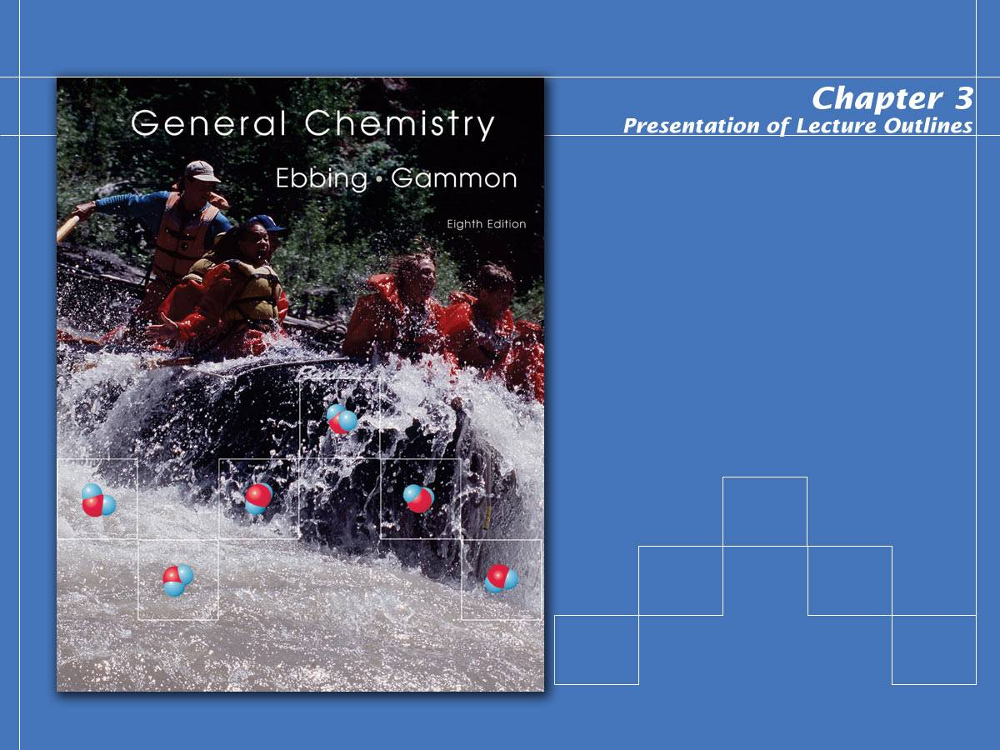
Calculations with Chemical Formulas and Equations
3.6 Molar Interpretation of a Chemical Equation
3.7 Amounts of Substances in a Chemical Reaction
3.8 Limiting Reactant, % Yields

Slide 26
Problems for Lab 5 Report
Lab 5 Part 2
Measure the volume of your sand using a graduated cylinder. Knowing the number of grains of sand in your beaker and the volume, calculate the volume of one mole of grains of sand using Avogadro’s number. Show all calculations.
6.02x10²³ gr(100 cm³ /116,100 gr)(1 in/2.54 cm)³
(1 ft/12 in)³(1 mile/5280 ft)³ = 1.24 x 10⁵ mi³

Slide 27
Problems for Lab 5 Report
Lab 5 Part 2
5. If the stars mentioned in prelab question 5 were the size of a grain of sand, what weight of sand in pounds would that be? Do you think Pismo Beach is big enough to contain that much sand?
4x10¹¹stars(gr)(116.100g/116,100gr)
(1 lb/454g) = 881,912 lbs = 8.82x10⁵ lbs

Slide 28
Problems for Lab 5 Report
Lab 5 Part 2
5. If the stars mentioned in prelab question 5 were the size of a grain of sand, what weight of sand in pounds would that be? Do you think Pismo Beach is big enough to contain that much sand?
4x10¹¹stars(gr)(100 cm³/116,100gr)
(1 in/2.54 cm)³(1 ft/12)³ = 1.22x10⁴ ft³
( or about 27 yards of a football field)

Slide 29
Stoichiometry: Quantitative Relations in Chemical Reactions
Stoichiometry is the calculation of the quantities of reactants and products involved in a chemical reaction.
It is based on the balanced chemical equation and on the relationship between mass and moles.
Such calculations are fundamental to most quantitative work in chemistry.
Notes:
2

Slide 30
Molar Interpretation of a Chemical Equation
The balanced chemical equation can be interpreted in numbers of molecules, but generally chemists interpret equations as “mole-to-mole” relationships.
For example, the Haber process for producing ammonia involves the reaction of hydrogen and nitrogen.
Notes:
2

Slide 31
Molar Interpretation of a Chemical Equation
This balanced chemical equation shows that one mole of N₂ reacts with 3 moles of H₂ to produce 2 moles of NH₃.
1 molecule N₂ + 3 molecules H₂ 2 molecules NH₃
Because moles can be converted to mass, you can also give a mass interpretation of a chemical equation.
Notes:
2

Slide 32
Molar Interpretation of a Chemical Equation
Suppose we wished to determine the number of moles of NH₃ we could obtain from 4.8 mol H₂.
Because the coefficients in the balanced equation represent mole-to-mole ratios, the calculation is simple.
Notes:
2

Slide 33
Mass Relationships in Chemical Equations
Amounts of substances in a chemical reaction by mass.
How many grams of HCl are required to react with 5.00 grams manganese (IV) oxide according to this equation?
Notes:
2

Slide 34
Mass Relationships in Chemical Equations
First, you write what is given (5.00 g MnO₂) and convert this to moles.
Then convert to moles of what is desired.(mol HCl)
Finally, you convert this to mass (g HCl)
Notes:
2

Slide 35
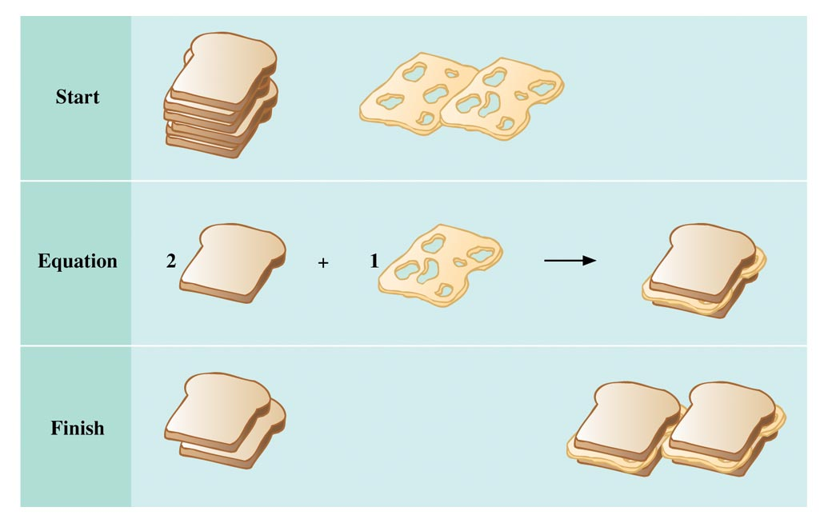
Limiting Reagent
The limiting reactant (or limiting reagent) is the reactant that is entirely consumed when the reaction goes to completion. The limiting reagent ultimately determines how much product can be obtained.
For example, bicycles require one frame and two wheels. If you have 20 wheels but only 5 frames, it is clear that the number of frames will determine how many bicycles can be made.
Notes:
2

Slide 36
Limiting Reactant Links
http://xbeams.chem.yale.edu/~batista/113/Chapter4/ch4.ppt
http://www.lsua.us/chem1001/stoichiometry/aabtgzm0.mov

Slide 37
Limiting Reagent
Zinc metal reacts with hydrochloric acid by the following reaction.
If 0.30 mol Zn is added to hydrochloric acid containing 0.52 mol HCl, how many moles of H₂ are produced?
Notes:
2

Slide 38
Limiting Reagent
Take each reactant in turn and ask how much product would be obtained if each were totally consumed. The reactant that gives the smaller amount is the limiting reagent.
Since HCl is the limiting reagent, the amount of H₂ produced must be 0.26 mol.
Notes:
2

Slide 39
Theoretical and Percent Yield
The theoretical yield of product is the maximum amount of product that can be obtained from given amounts of reactants.
The percentage yield is the actual yield (experimentally determined) expressed as a percentage of the theoretical yield (calculated).
Notes:
2

Slide 40
Theoretical and Percent Yield
To illustrate the calculation of percentage yield, recall that the theoretical yield of H₂ in the previous example was 0.26 mol (or 0.52 g) H₂.
If the actual yield of the reaction had been 0.22 g H₂, then
Notes:
2

Slide 41
H₂ + I₂ → HI
2
How many grams of HI can be formed from 2.00 g H₂ and 2.00 g of I₂?
2.00 g
2.00 g
?
1 mole H₂ 2 mole HI 127.9124g HI
2.00 g H₂ -------------- ------------- ------------------- =
254 g HI
2.0158 g 1 mole H₂ 1 mole HI
1 mole I₂ 2 moles HI 127.9124g HI
2.00g I₂ ------------- --------------- ----------------- =
2.02 g HI
253.810 g 1 mole I₂ 1 mole HI
Limiting Reactant is always the smallest value!
I₂ is the limiting reactant and H₂ is in XS.

Slide 42
C₃H₈ + O₂ → CO₂ + H₂O
5
3
4
How many grams of CO₂ can be formed from 1.44 g C₃H₈ and 2.65 g of O₂?
1.44 g
2.65g
?
1 mole C₃H₈ 3 mole CO₂ 44.009 g CO₂
4.31 g CO₂
1.44 g C₃H₈ ---------------- ---------------- ------------------- =
44.0962 g 1 mole C₃H₈ 1 mole CO₂
1 mole O₂ 3 moles CO₂ 44.009 g CO₂
2.19 g CO₂
2.65g O₂ ------------- ----------------- ------------------- =
31.998 g 5 mole O₂ 1 mole CO₂
O₂ is the limiting reactant and C₃H₈ is in XS.

Slide 43
C₃H₈ + O₂ → CO₂ + H₂O
5
3
4
1 mole O₂ 3 moles CO₂ 44.009 g CO₂
2.19 g CO₂
2.65g O₂ ------------- ----------------- ------------------- =
31.998 g 5 mole O₂ 1 mole CO₂
Suppose that in actual practice you obtain 1.03 g of CO₂. What would be the % yield?
grams actual
% yield = ----------------------- x 100%
grams theoretical
1.03 g
% yield = --------- x 100% = 47.0 % yield CO₂
2.19 g

